Slide 1
Week 2 Report
By: Jacob Lin
Week of 6/7 – 6/13

Slide 2
This week’s goals (from last week)
By Monday:
  Do more research/learning
  Find examples of other image registrations applications
  Trying to find a very easy code for very simple image registration
By Friday:
  Try to understand the code from above
  Coming up with 1+ strong ideas (hopefully at least one idea)

Slide 3
Weekend Report Part 1: 6/7 – 6/9 summary
Learned:
  Feature detection algorithm from OpenCV
  Feature matching algorithm from OpenCV
UMD GPU Access
Other examples/usages of Computer Vision
Resources

Slide 4
Feature Detection Algorithm from OpenCV
Harris Corner detection:
  Finds gradient of every point on the image intensity, then computes a probability of it being a corner
Shi-Tomasi Corner detection:
  Similar to Harris but uses eigenvalues of the matrix
Scale-Invariant Feature Transformation (SIFT):
  Makes a copy that uses Gaussian filters (convolution but with a Gaussian function)
  Then subtract the old image by the filtered image
Speeded-Up Robust Features (SURF)
  Similar to SIFT, but uses Hessian matrix as the detector

Slide 5
Feature Matching from OpenCV2
Background info: Given picture 1 and picture 2
Find key features of both images (Like the one in week 1)
  Each key feature will have their own integer valued descriptors which contains a variety of details (I don’t believe it will be an importance)
For each descriptors of picture 1, calculate the norm between the all of the descriptors of picture 2 then ranked by the lowest norm.
Find the Kth nearest neighbors (in terms of lowest rankings)
Conduct a ratio test with a threshold to make a list of matches
Make a transformation matrix from the matches

Slide 6
UMD GPU access
https://hpcc.umd.edu/hpcc/getting-access.html
Overall:
  Paid service
  Needs permission:
    Either another UMD faculty who has access
    Request access
Seems like a lot of work to get access, will consider if my computer is not powerful enough
  My computer specs: 3060 GPU (Laptop version, 105 W), 5800H CPU, 16 GB RAM, 512 GB storage (main concern)

Slide 7
Other Examples/Usage of Computer Vision
Agriculture:
  Checks for diseases and crop monitoring
Manufacturing Quality control
Security

Slide 8
Resource
https://github.com/PacktPublishing/Applied-Deep-Learning-and-Computer-Vision-for-Self-Driving-Cars?tab=readme-ov-file
Repository for a book on self-driving cars, it follows the chapter of the following book.
Goes through step by step of everything
Will probably read through this over the next few weeks

Slide 9
Blockers / Concerns
Same as last week

Slide 10
Expectations for the weekday
Same as last week

Slide 11
Weekday report: 06/10 – 06/13
Slow weekday
Learned:
  Convolution in SIFT
  SIFT for images
Pushed to next week: generating idea
Plans for next week

Slide 12
Learned: Convolution in SIFT
Mistake from weekend research, it is not the same as the convolutions from CNN. Mixed the terms for pooling and convolutions.
The convolution part comes from the Gaussian blurring of the images.

Slide 13
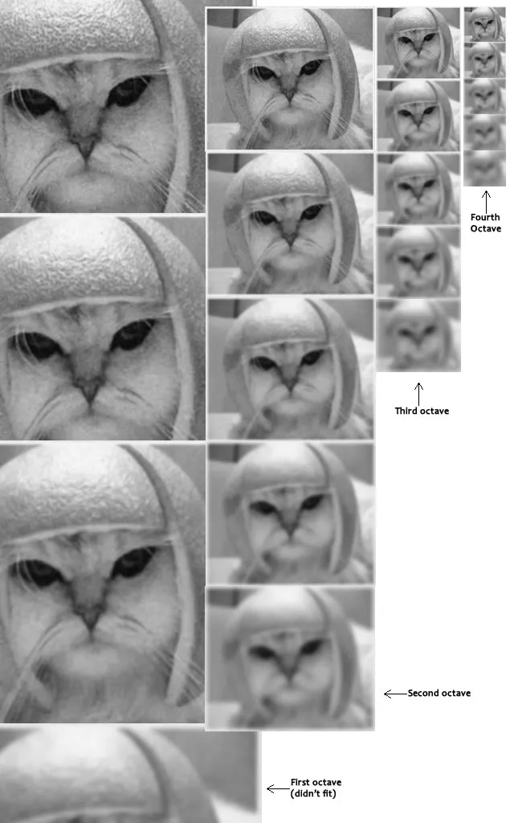
Learned: SIFT for Images (1/2)
Scale-Space Construction
  Detects key points which are invariant to scale
  From the original image, progressively halves the images (octave) and make apply the gaussian blur, making it blurrier every octave.
Difference of Gaussians (DoG)
  Identifies the key points
  For each octave, subtract the consecutively blurred images from above
Keypoint Localization
  Locates the key points from the identified ones
  Find extrema of DoGs
  Use a Taylor expansion of the DoG to fit into a 3D polynomial function
  Compute the Hessian from the given polynomial function

Slide 14
Learned: SIFT for Images (2/2)
Orientation Assignment
  Finds rotational invariance
  Compute the gradient for each pixel
  Create a orientation histogram with 36 points (for the 360 degrees)
Keypoint Descriptor:
  Creates a description around the keypoint
  Does orientation alignment
  Generates the descriptor
  Normalizes the descriptor

Slide 15
Postponed: Generate idea
Too ambitious goal
Postponed due to limited knowledge of neural networks
Problem: Need help on what to do for the input and output layer

Slide 16
Plans for next week
Research:
  Different input/output methods for neural networks
Playing with the new test data

